Slide 1
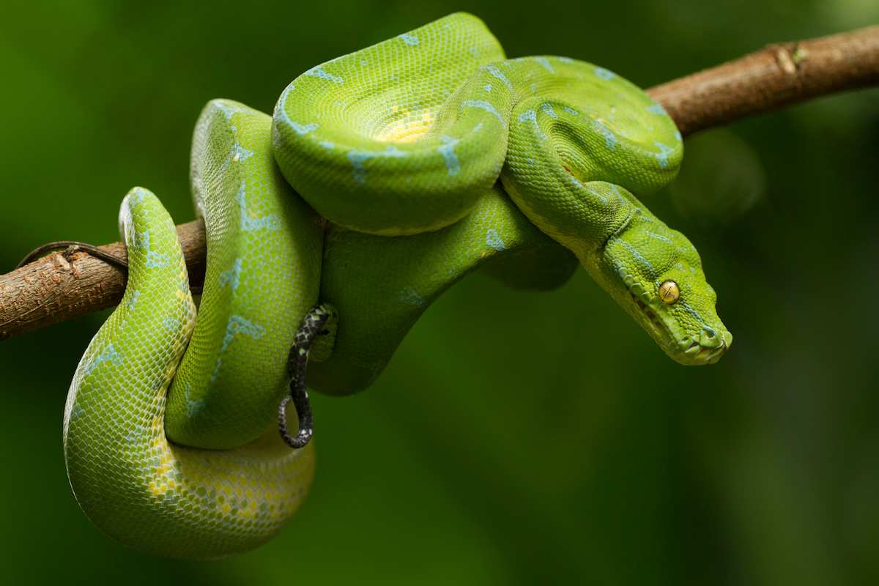
Python packages for Data Science
BIOL792 Fall 2022 – Week 11, python 6
Trevor Faske, Thomas Parchman

Slide 2
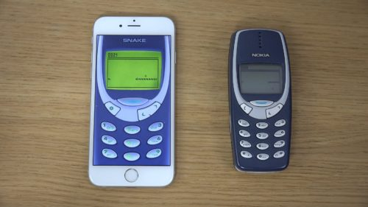

Base Python
Python with libraries

Slide 3
BIOL792 Fall 2022 – Week 11, python 6
Useful libraries and applications of python
Module: primer_python6_pandas.md
numpy
pandas
Ask anything!!!
assignment_6_python.md & answers

Slide 4
Ways to use python
Interactive through terminal
Scripting using text editor
IDE (Integrated Development Environment)
PyCharm
Spyder
Rstudio (now posit.co)
Anaconda / miniconda
Jupyter notebooks
Environments and repositories

Slide 5

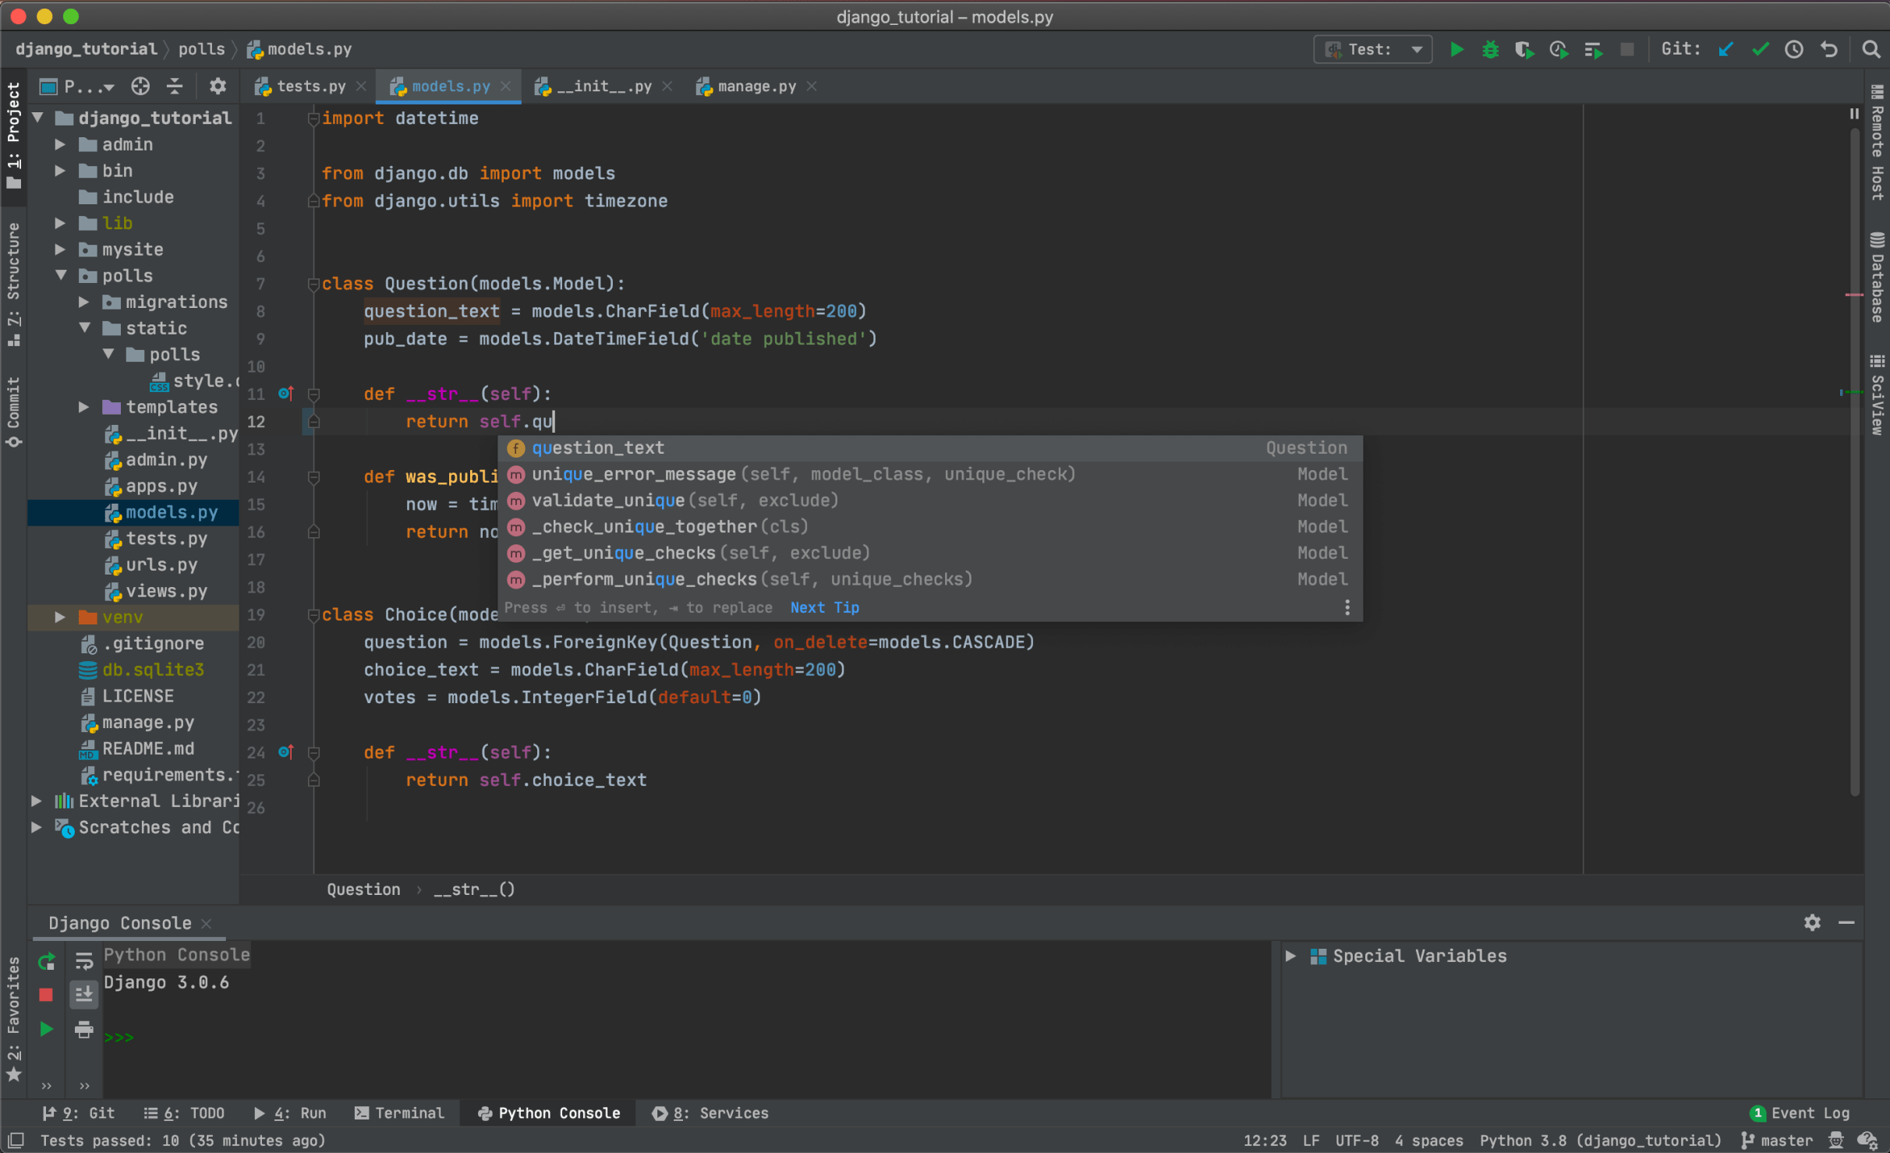
PyCharm

Slide 6

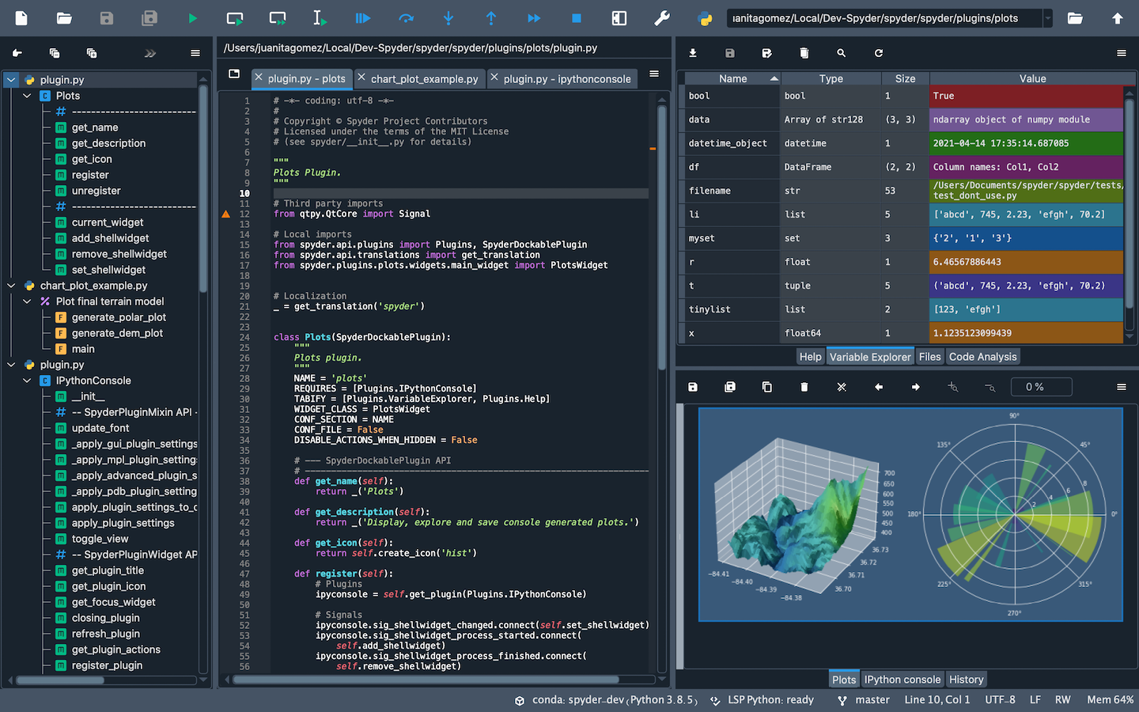
Spyder

Slide 7

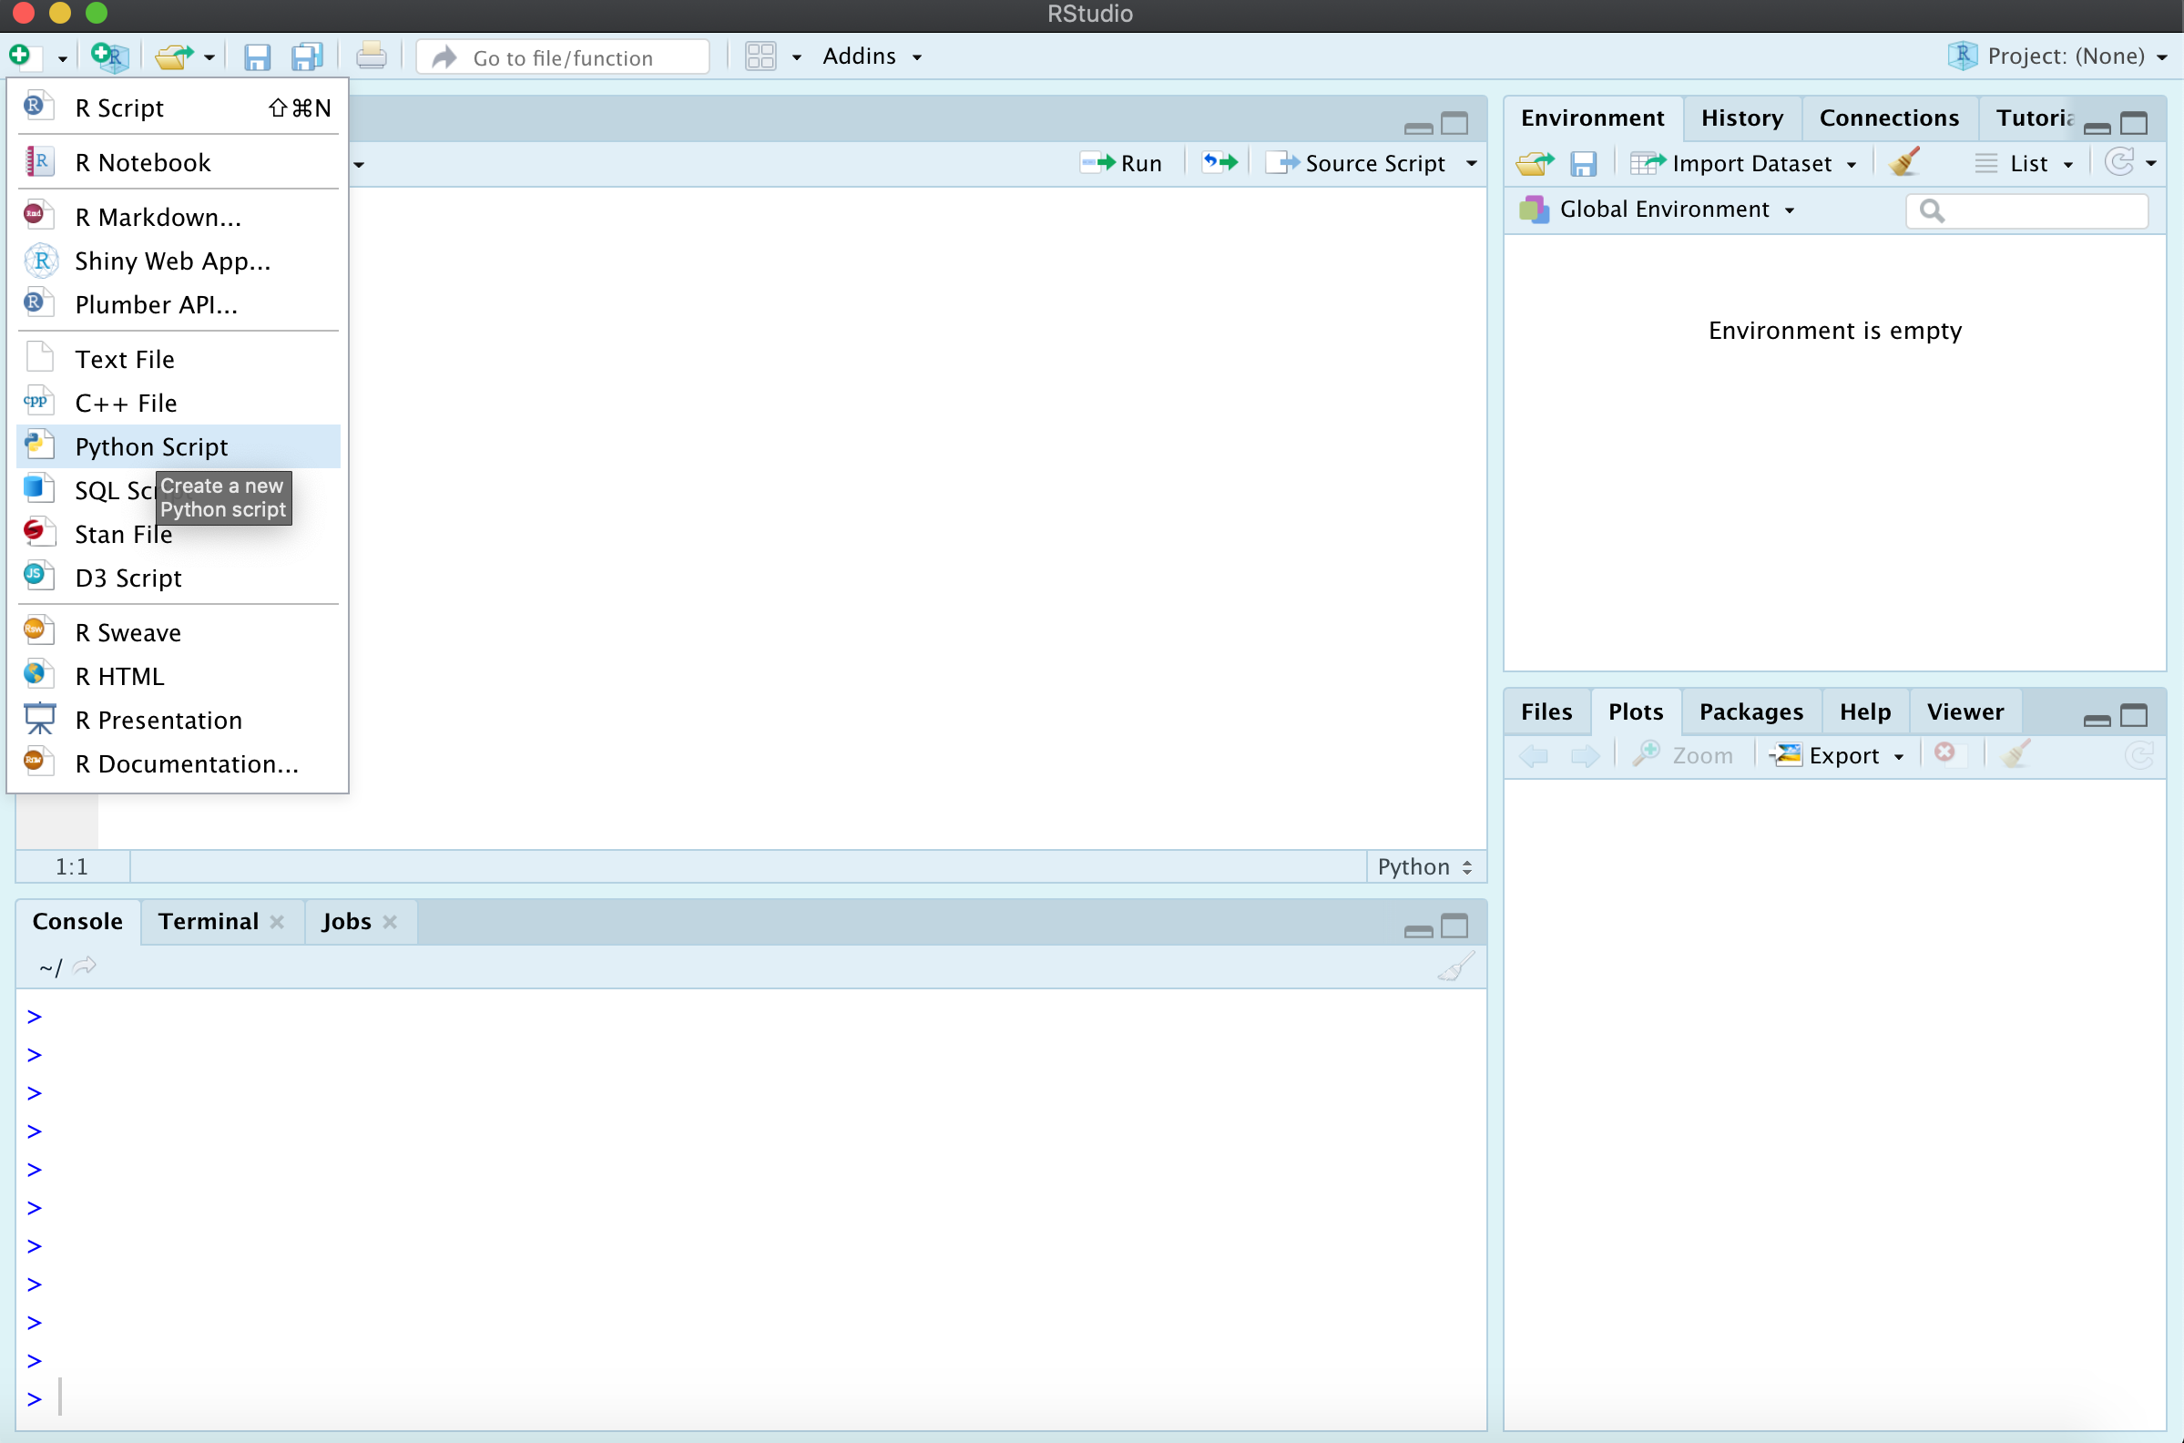
RStudio (reticulate)

Slide 8
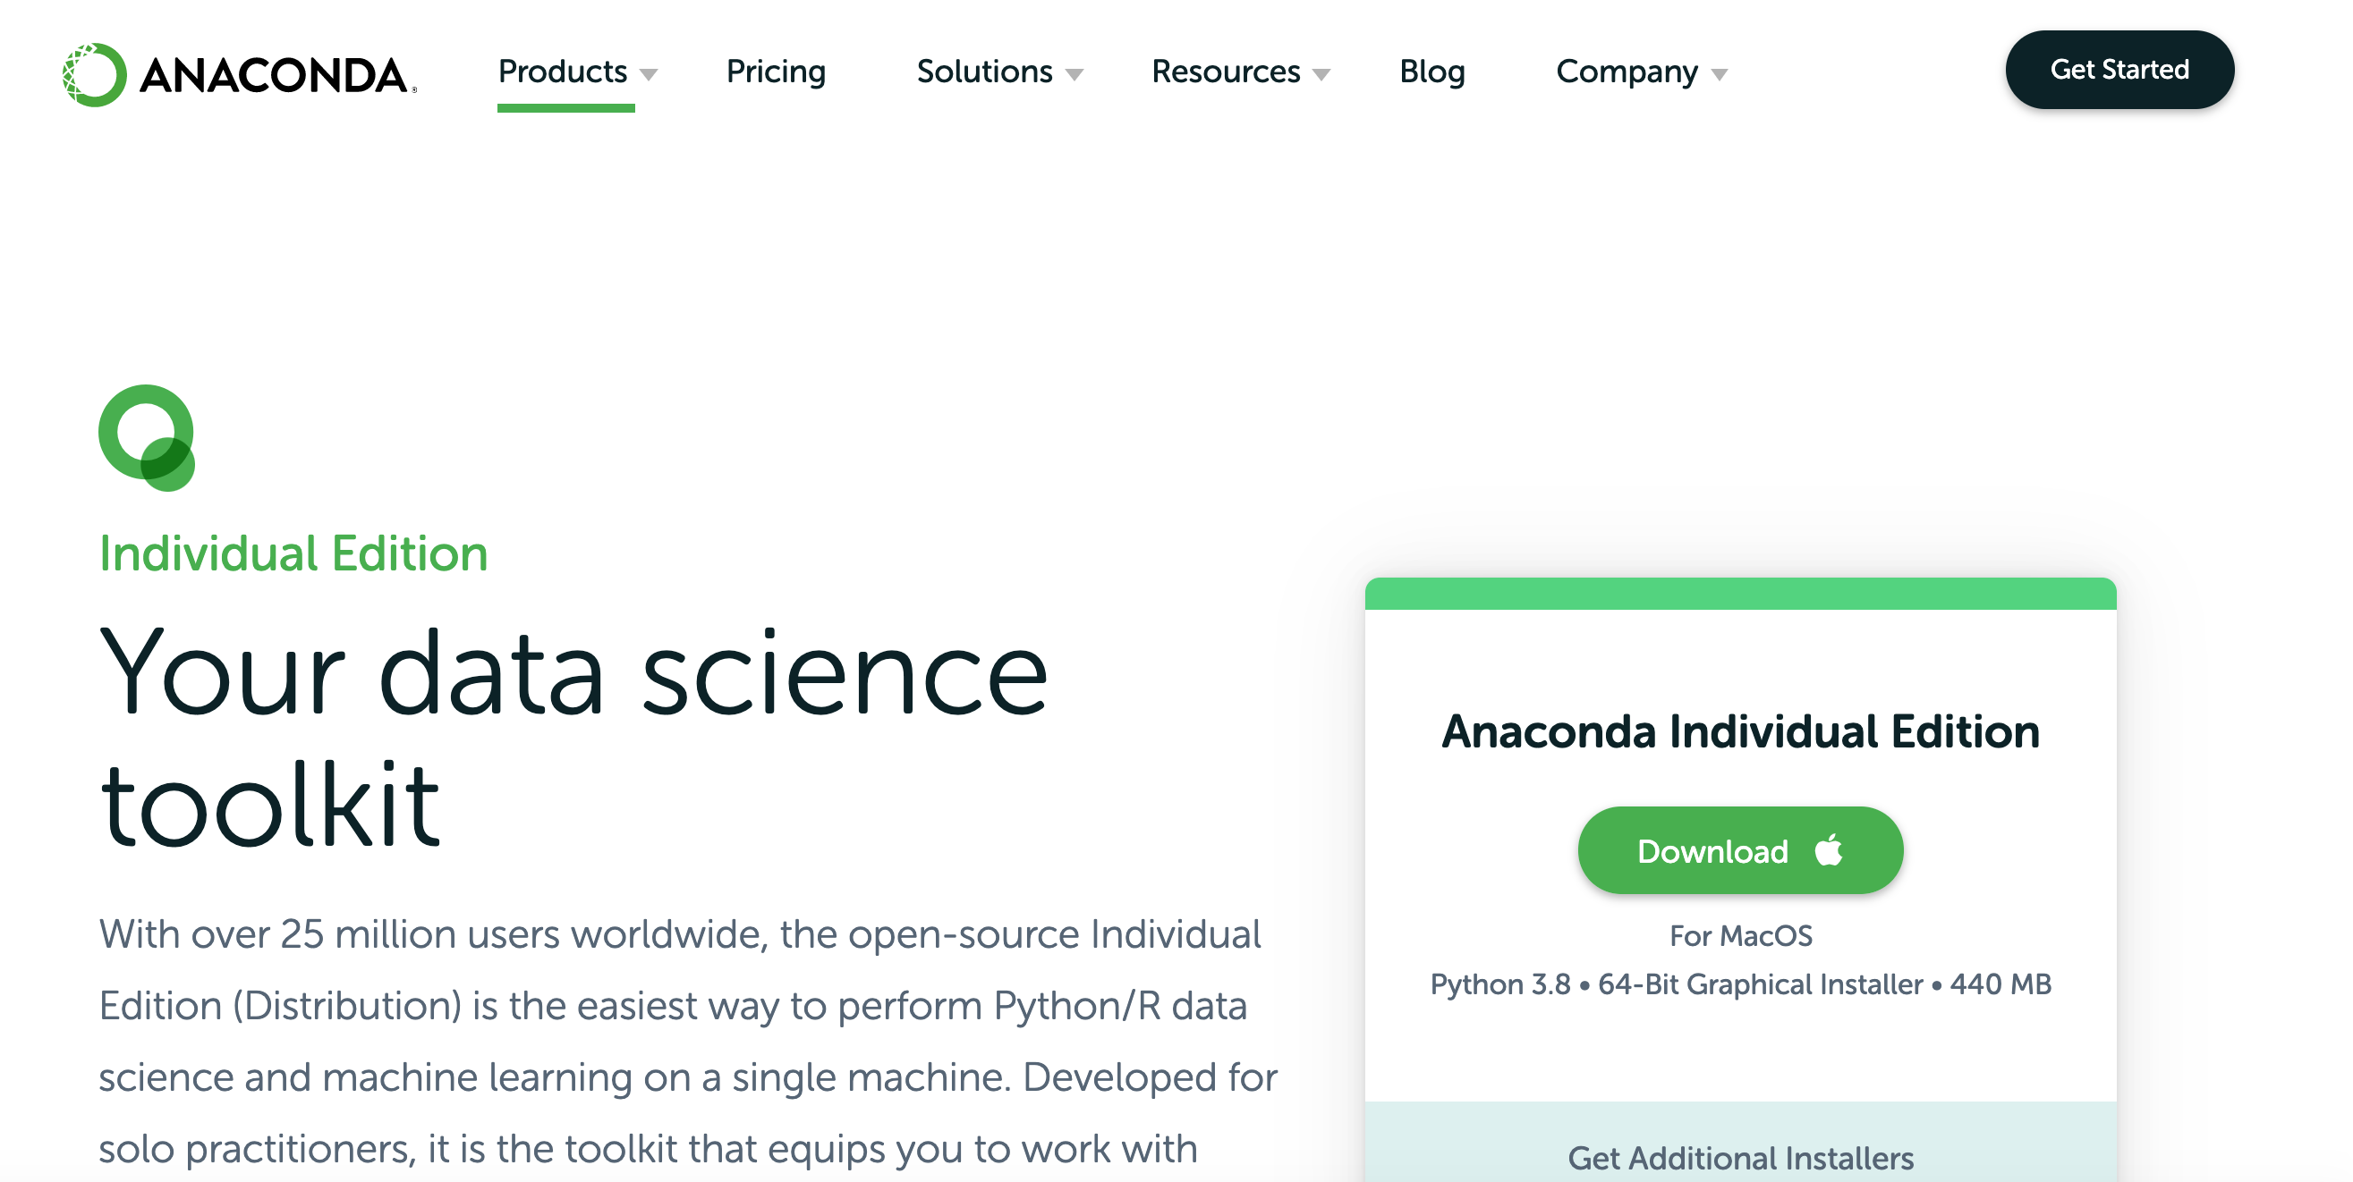
Anaconda

Slide 9
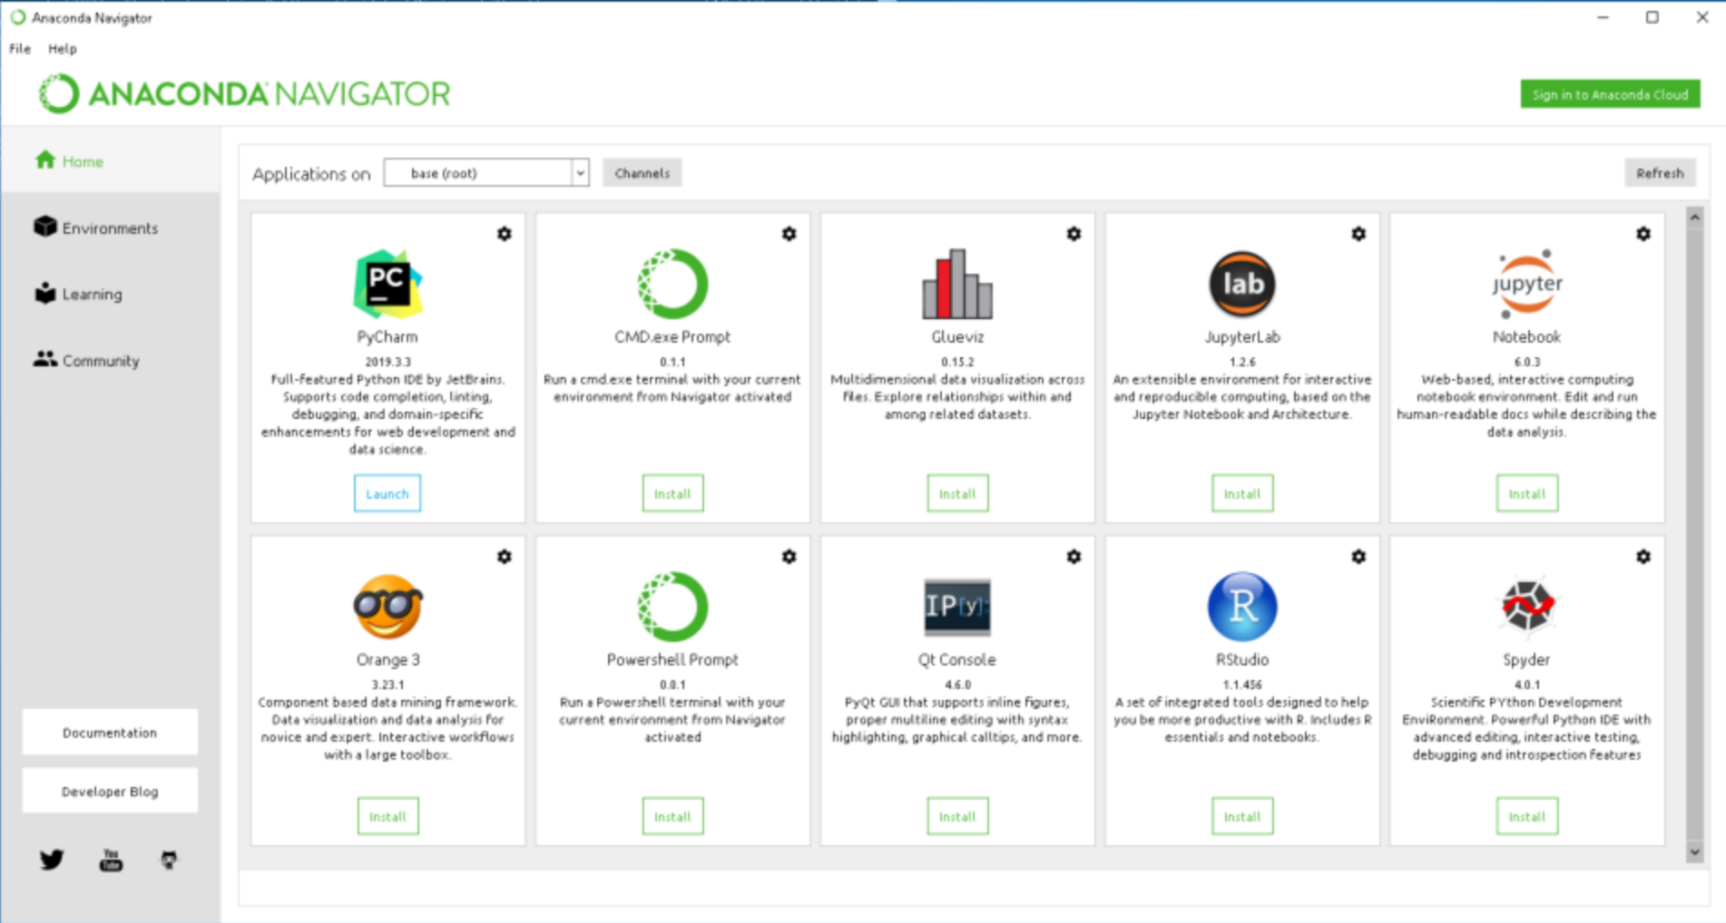

Slide 10
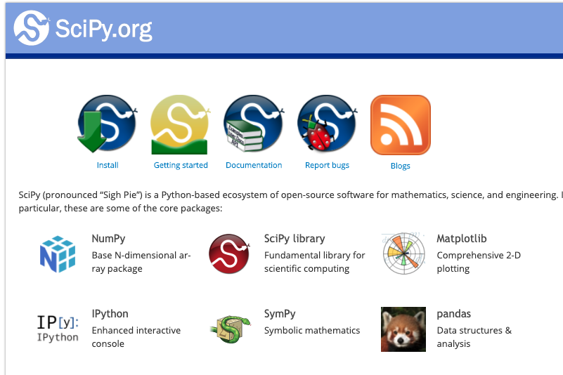
Python libraries
(137,000 estimated)

Slide 11
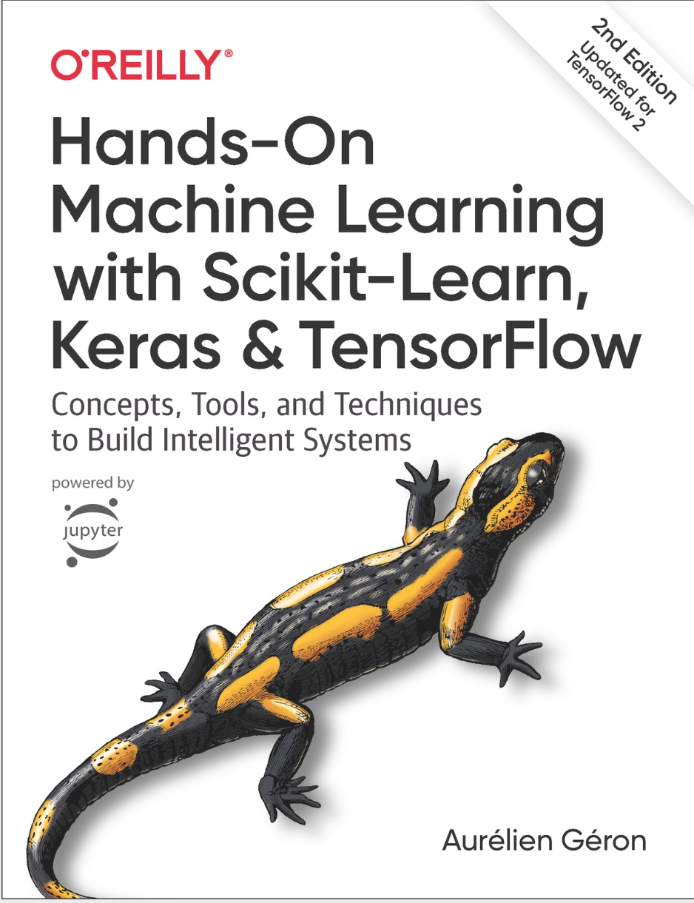

Machine Learning
Tensor Flow
Keras
Scikit-learn

Slide 12
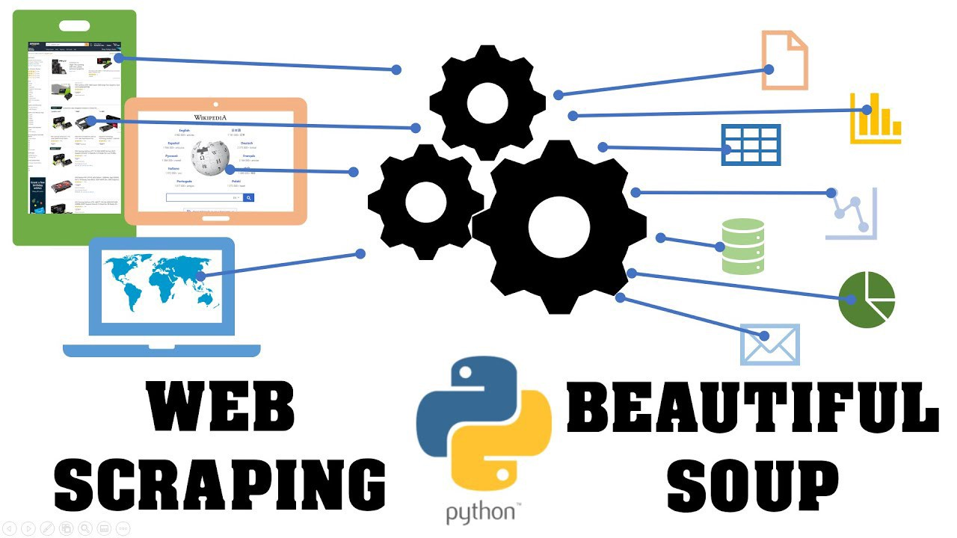

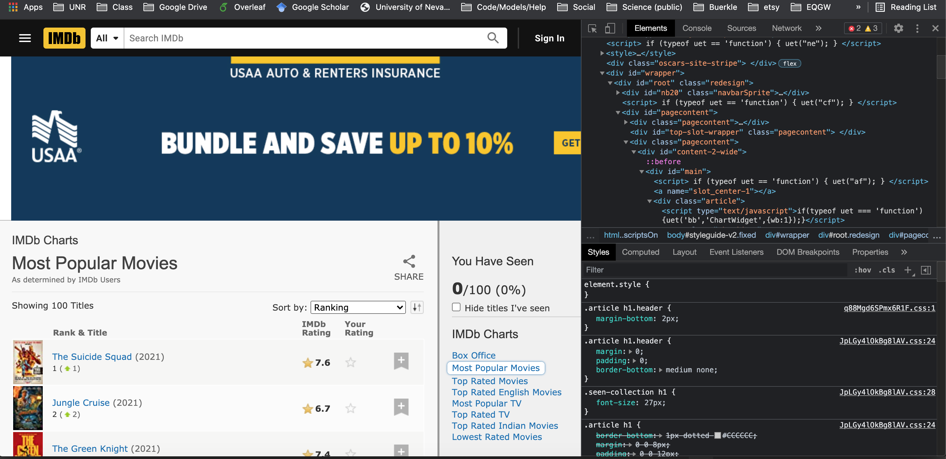
Web data scrapping

Slide 13
primer_python6_pandas.md
First, any additional python use questions?
Next, primer walk through. Follow along in interactive python

Slide 14
Installing python libraries
From the terminal / command line:
$ pip3 install package_name
$ pip3 install numpy
$ pip3 install pandas
$ pip3 install matplotlib
If you get a permissions error:
$ pip3 install --user package_name

Slide 15
Import and using libraries
Top of script in python
import os,re,sys (import multiple libraries in single line)
import numpy as np (import package as alias)
from numpy import DataFrame (import only specific function)
Common aliases universally used
import numpy as np
import pandas as pd
import matplotlib.pyplot as plt

